Slide 1
Artificial Intelligence (AI)
Instructor: Nguyen Truong Thinh, PhD
thinhnt@ueh.edu.vn
02/2023

Slide 2

Objectives History
Applications Biological Inspiration

Slide 3
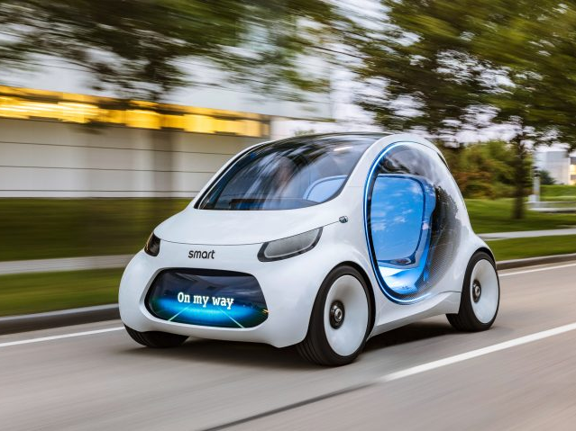
Application 1. Self-driving cars

Slide 4
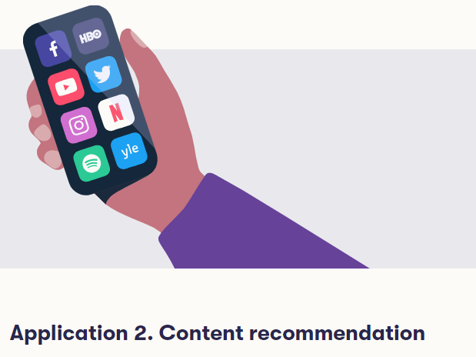
Social Networks: Facebook, Twitter, Instagram, and other social media content
Music recommendations on Spotify
Movie recommendations on Netflix, HBO, and other streaming services
Online publishers, Google also personalize the content they offer.

Slide 5

Content recommendation

Slide 6


Slide 7

Aerospace
Aircraft autopilote, flight path simulations
Aircraft control systems
Autopilot enhancements
Aircraft component simulations,
Aircraft component fault detectors

Slide 8
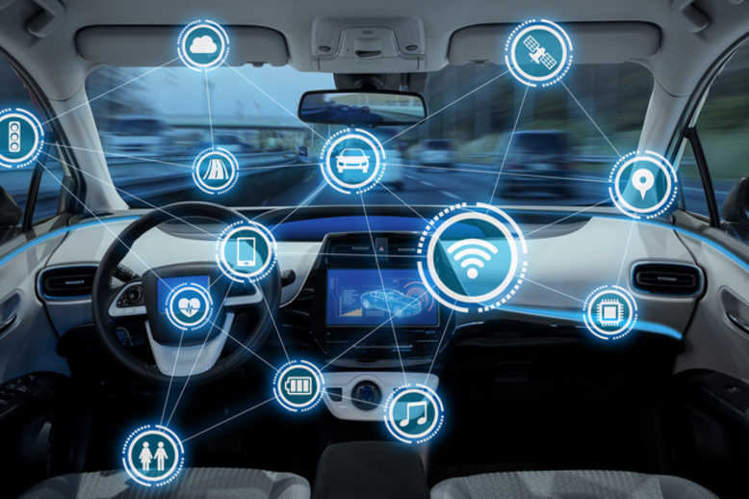

Slide 9
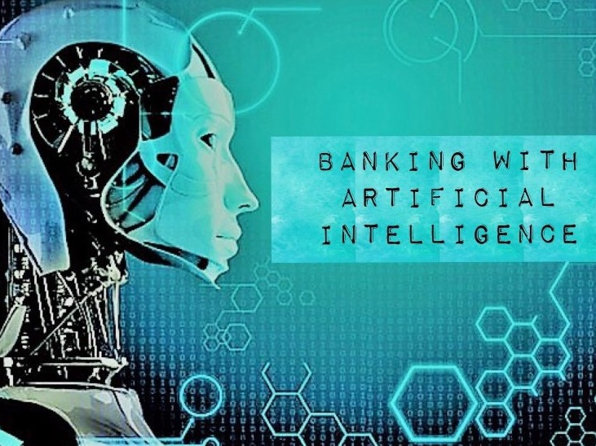

Slide 10
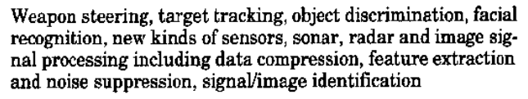
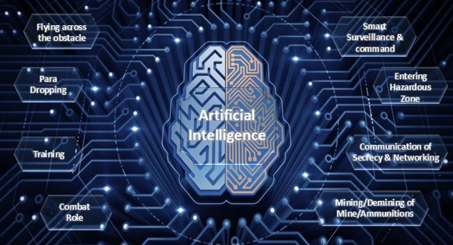
Defense

Slide 11
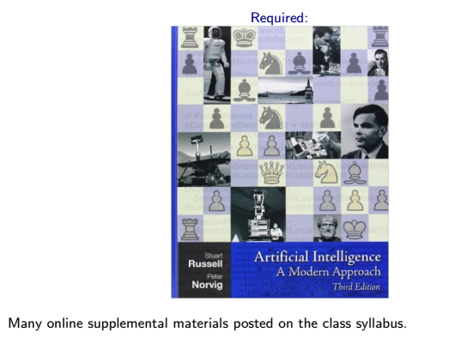
Textbook

Slide 12
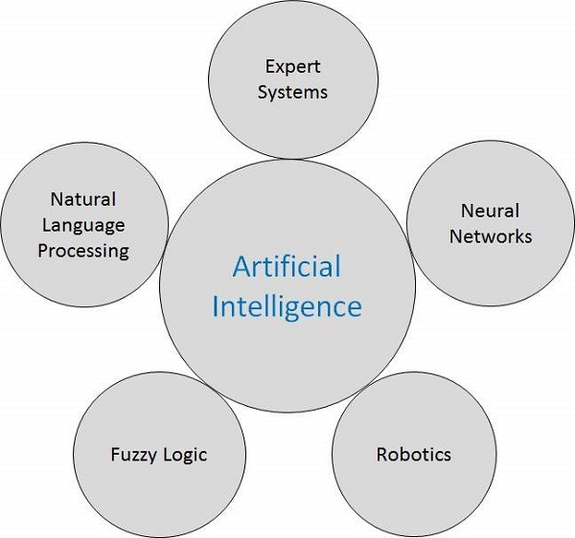
Artificial Intelligence - Research Areas

Slide 13
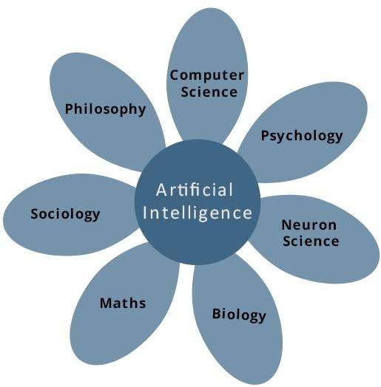
What Contributes to AI?

Slide 14
Programming Without and With AI
Programming Without AI | Programming With AI
A computer program without AI can answer the specific questions it is meant to solve. | A computer program with AI can answer the generic questions it is meant to solve.
Modification in the program leads to change in its structure. | AI programs can absorb new modifications by putting highly independent pieces of information together. Hence you can modify even a minute piece of information of program without affecting its structure.
Modification is not quick and easy. It may lead to affecting the program adversely. | Quick and Easy program modification.

Slide 15
Real Life Applications of AI Research Areas
Sr.No. | Research Areas
1 | Expert Systems Examples − Flight-tracking systems, Clinical systems.
2 | Natural Language Processing Examples: Google Now feature, speech recognition, Automatic voice output.
3 | Neural Networks Examples − Pattern recognition systems such as face recognition, character recognition, handwriting recognition.
4 | Robotics Examples − Industrial robots for moving, spraying, painting, precision checking, drilling, cleaning, coating, carving, etc.
5 | Fuzzy Logic Systems Examples − Consumer electronics, automobiles, etc.

Slide 16
Task Domains of Artificial Intelligence
Mundane (Ordinary) Tasks | Formal Tasks | Expert Tasks
Perception Computer Vision Speech, Voice | Mathematics Geometry Logic Integration and Differentiation | Engineering Fault Finding Manufacturing Monitoring
Natural Language Processing Understanding Language Generation Language Translation | Games Go Chess (Deep Blue) Ckeckers | Scientific Analysis
Common Sense | Verification | Financial Analysis
Reasoning | Theorem Proving | Medical Diagnosis
Planing |  | Creativity
Robotics Locomotive

Slide 17
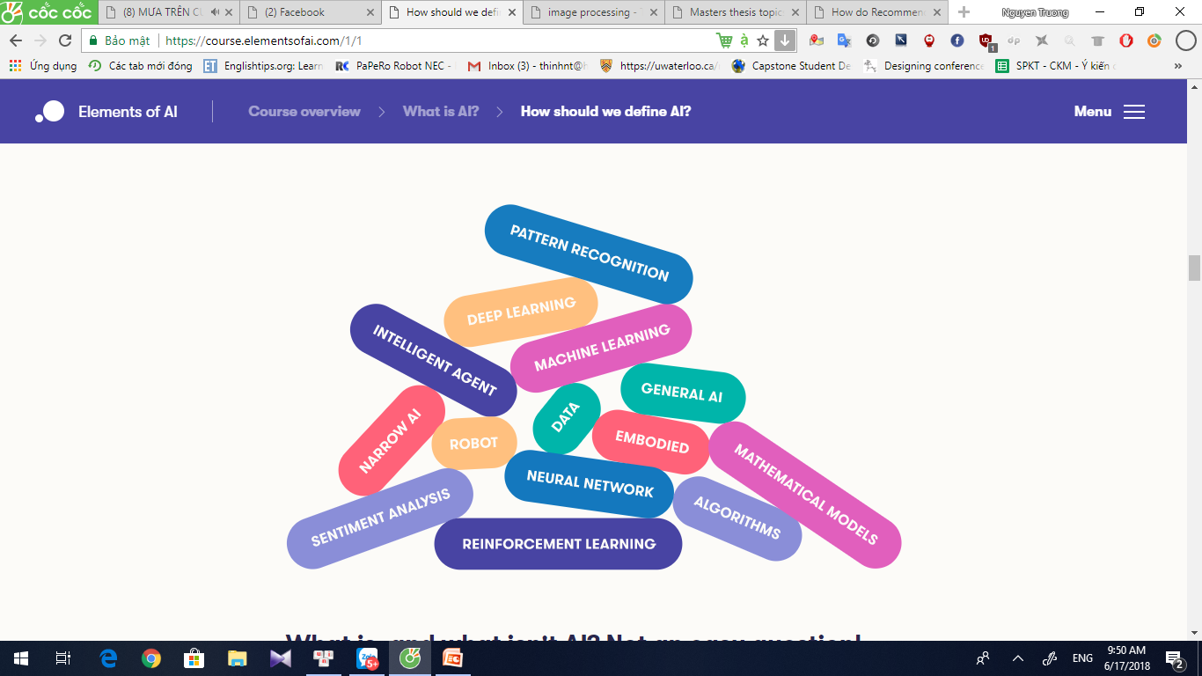
What is, and what isn't AI? Not an easy question!

Slide 18
Types of Intelligence
Intelligence | Description
Linguistic intelligence | The ability to speak, recognize, and use mechanisms of phonology (speech sounds), syntax (grammar), and semantics (meaning).
Musical intelligence | The ability to create, communicate with, and understand meanings made of sound, understanding of pitch, rhythm.
Logical-mathematical intelligence | The ability of use and understand relationships in the absence of action or objects. Understanding complex and abstract ideas.
Spatial intelligence | The ability to perceive visual or spatial information, change it, and re-create visual images without reference to the objects, construct 3D images, and to move and rotate them.

Slide 19
Types of Intelligence
Intelligence | Description
Bodily-Kinesthetic intelligence | The ability to use complete or part of the body to solve problems or fashion products, control over fine and coarse motor skills, and manipulate the objects.
Intra-personal intelligence | The ability to distinguish among one’s own feelings, intentions, and motivations.
Interpersonal intelligence | The ability to recognize and make distinctions among other people’s feelings, beliefs, and intentions.

Slide 20
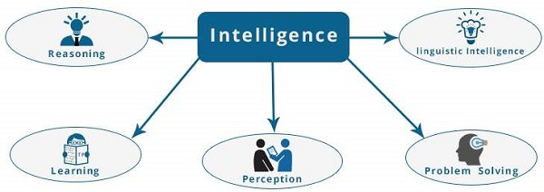
What is Intelligence Composed of?

Slide 21
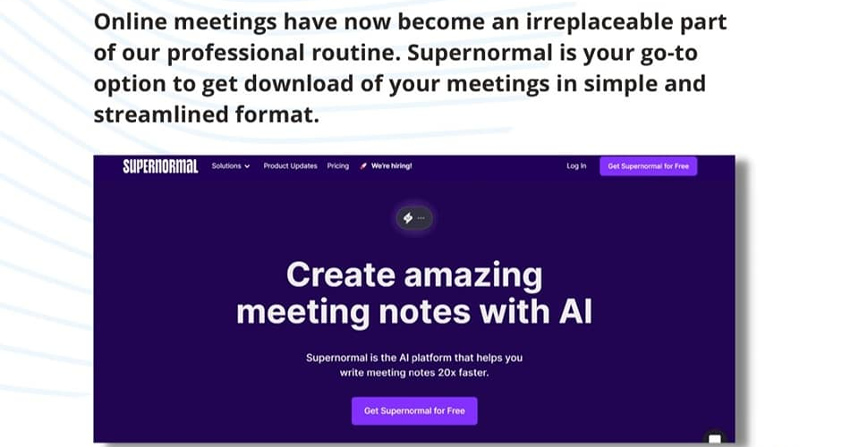
Supernormal
Supernormal is an AI that helps you write your meeting notes 20x faster

Slide 22
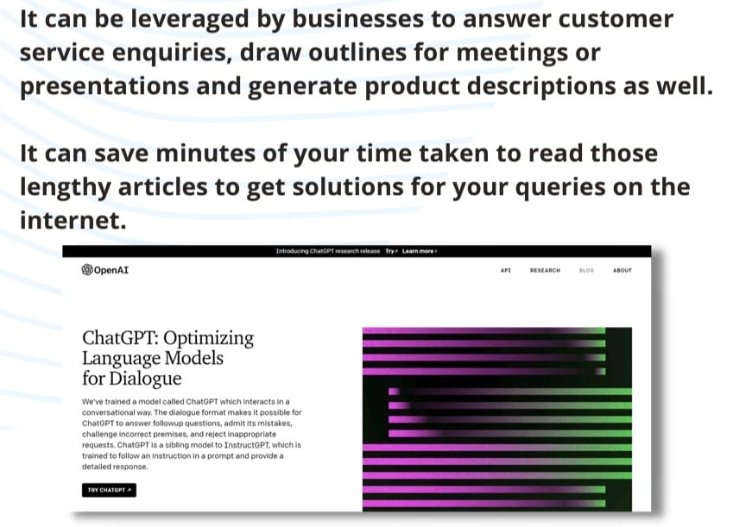
ChatGPT
ChatGPT is a great AI bot capable of producing human-like responses

Slide 23
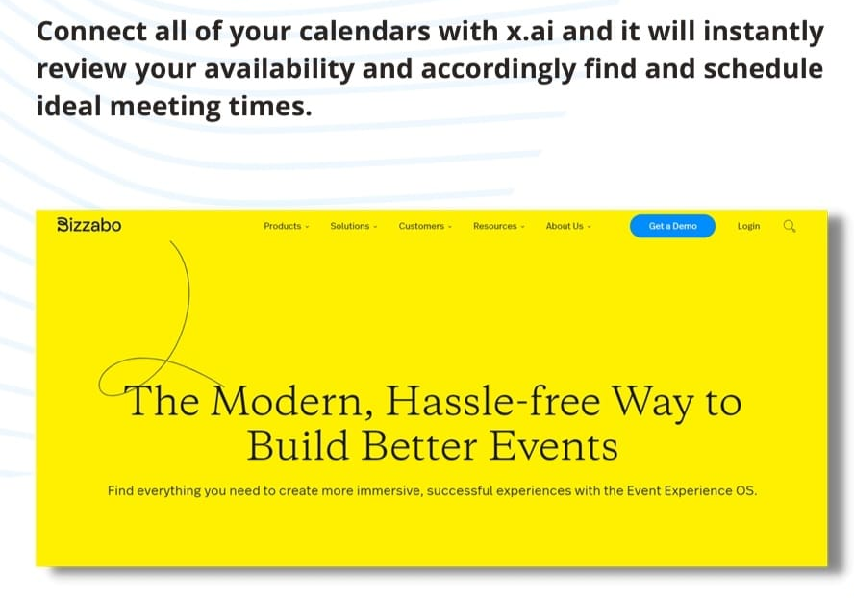
x.AI
An AI-powered personal assistant that helps schedule meetings and manage email communication

Slide 24
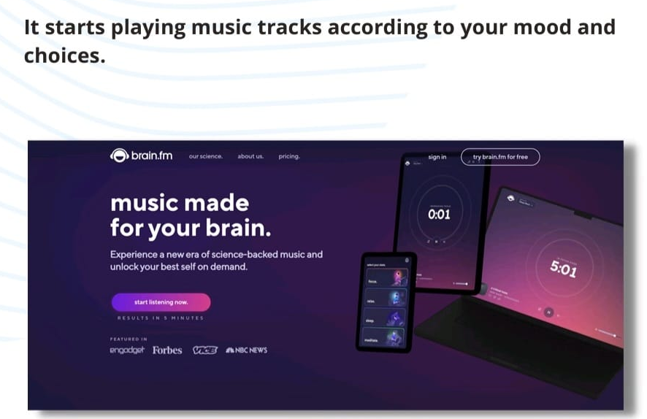
Brain.fm
Brain.fm uses AI and provides you with a range of tracks that improves your focus, productivity, meditation, and sleep.

Slide 25
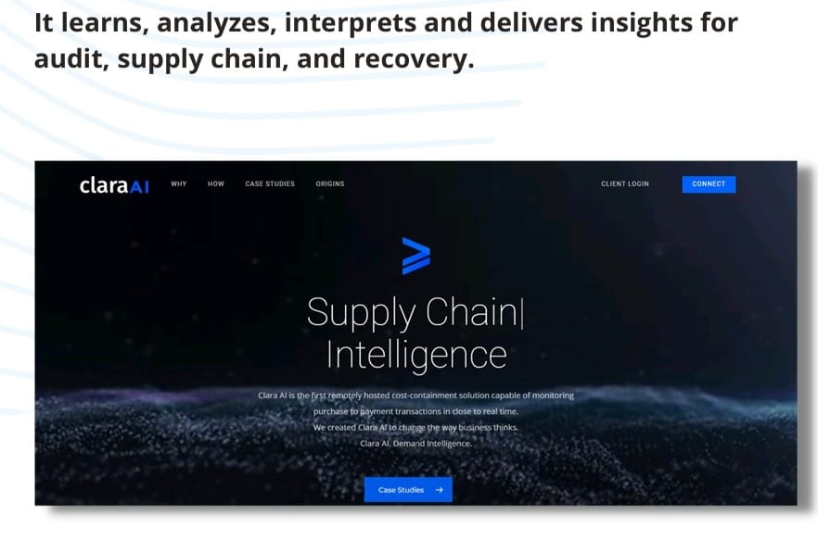
Clara AI
Clara AI is a remotely hosted AI as a Service (AIaaS) that has the ability to learn specific business requirements and provide suggestions for improvement.

Slide 26
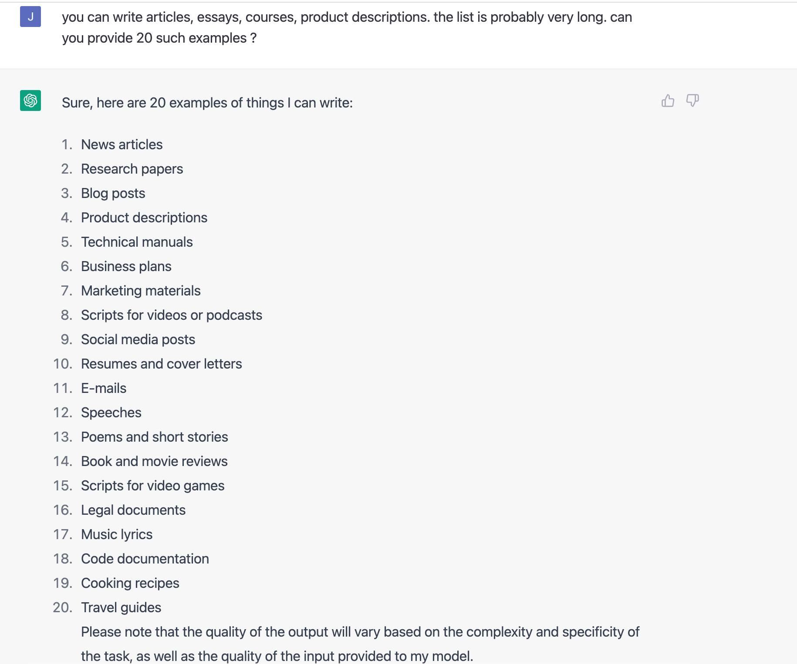
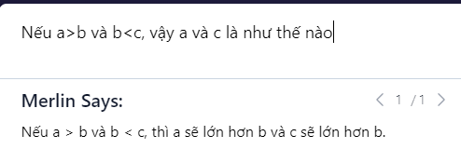
1. Blog posts
2. Poems
3. News articles
4. Short stories
5. Book reviews
6. Website content
7. Press releases
8. Social media posts
9. Video scripts
10. Tutorials
11. Product Descriptions
12. Technical manuals
13. Magazine articles
14. Manuals
15. eBooks
16. Brochures
17. Reports
18. Interviews
19. White papers
20. Reviews

Slide 27
Poem by Chat GPT!
Cuộc đời như sắc hoa,
Lấp lánh trong ánh sáng mới.
Tình yêu trắng sang,
Tự do về tâm hồn.
Với mỗi giây phút,
Cố gắng cải thiện tâm trí.
Tăng thêm năng lượng,
Cho những ngày sắp đến.
Cuộc đời như sức mạnh,
Trong trái tim bền lâu.
Kết liễu những khó khăn,
Và ngày mới đến ngay.
Cuộc đời là hành trình,
Tìm hiểu bí ẩn thế giới.
Nắm giữ những kỷ niệm,
Và ôm những giấc mơ.

Slide 28
The relationship between AI, ML, DL
AI
Machine Learning
Deep Learning
1950
1980
2010

Slide 29
A brief history of AI
Year | Landmark
1956 | The concept AI was proposed at the Darrmouth Conference
1959 | Authur Samuel proposed Machine Learning
1956-1976 | The First Booming Period: The definition and development target of AI was clarified at the Dartmouth Conference
1976 | The failure of projects such as machine translation and the negative influence of some academic reports led to the reduction of investment ti AI in all spheres
1976-1982 | The first AI Winter: AI was under criticism and question, insufficient computing power, complicate operation, and hard to realize common sense and inference
1985 | The decision tree models with better visualization and multi-layer ANNs which overcame the limit of early perceptron was introduced
1982-1987 | The second Booming Period: The expert system with inference capacities based on logic and rules and can answer questions of certain fields prevailed. The fifth generation computers developed
1987 | The market of ISP (Internet Service Providers) collapsed

Slide 30
A brief history of AI
Year | Landmark
1987-1997 | The second AI winter: the Technical fields ran into bottleneck once again. The abstract inference was no longer the focus of people and the models based on processing were not welcomed
1997 | Deep Blue defeated the world chess Champion Garry Kasparov
2006 | Geoffrey Hinton and his students prompted the wave of deep learning
1997-2010 | Recovery Period: Computing performance was improved, and the Internet technologies got popularized very quickly.
2010 | The world ushered into the era of big data
2014 | Microsoft released the world’s first personal AI assistant Cortana
2016 | AlphaGo defeated the world Go Champion Lee sedol by 4:1
2017 | Deep Mind launched the strongest version of the program- AlphaGo zero
2010-Now | Rapid Growth Period: The new generation of information technology triggered the revolution in information environment and data foundations. The multi-model data built on massive images, voices and texts emerged. The computing power was greatly enhanced.

Slide 31
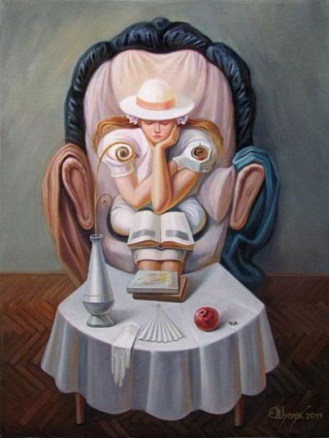
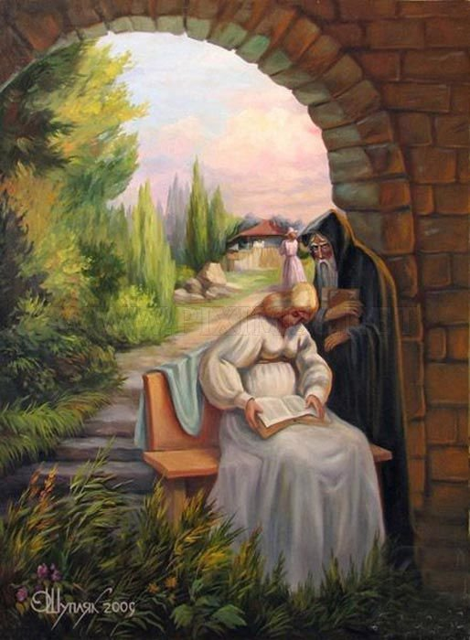

Three Main Schools of AI - Symbolism

Slide 32
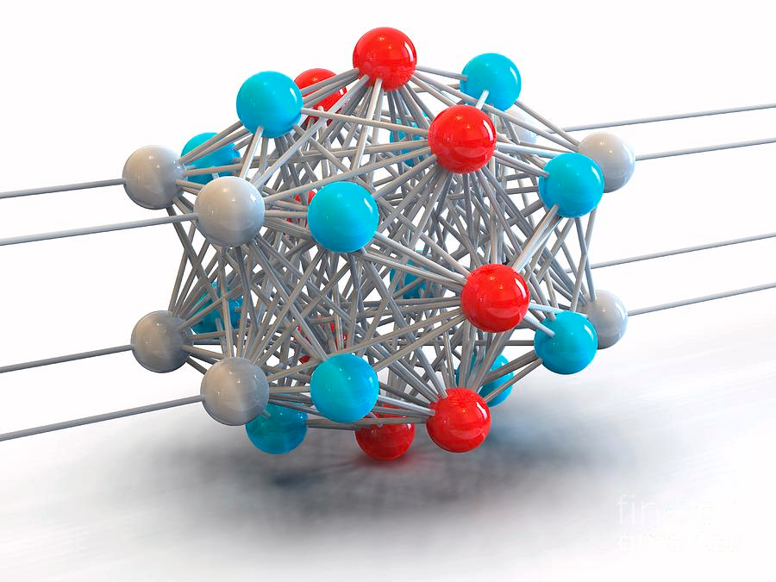
Three Main Schools of AI - Connectionism

Slide 33
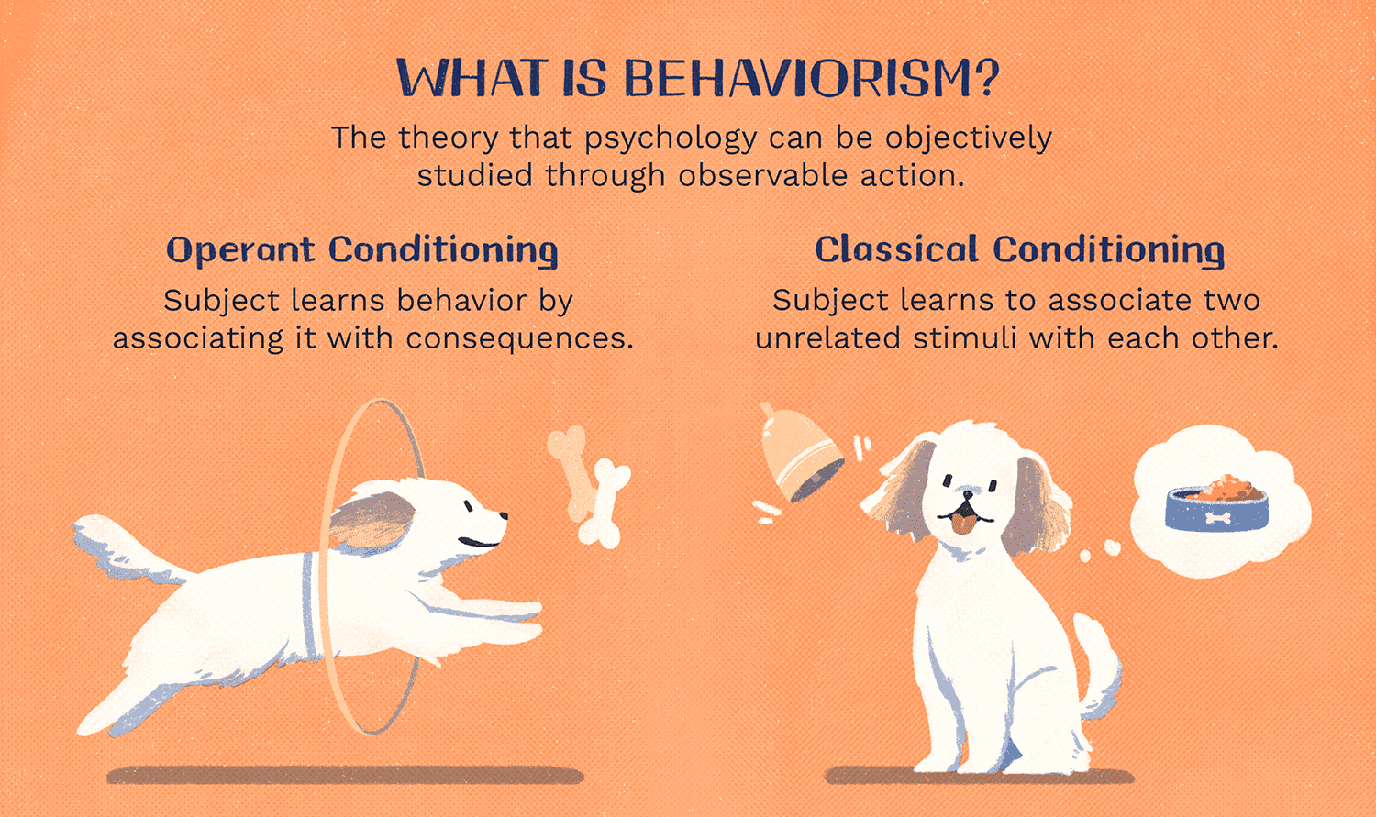
Three Main Schools of AI - Behaviorism

Slide 34
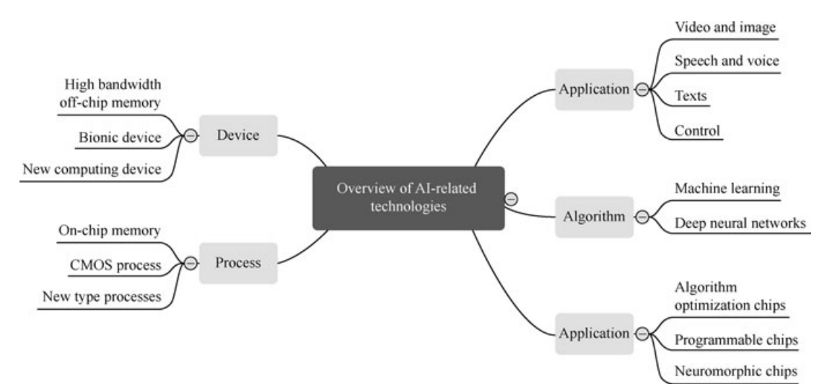
AI-Related Technologies

Slide 35
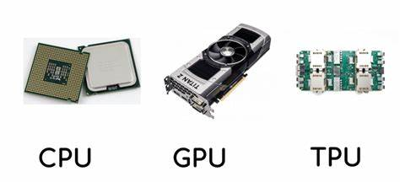
AI Processor
Central processing unit (CPU)
Graphics processing unit (GPU)
Application specific integrated circuit (ASIC)
Field programmable gate array (FPGA)

Slide 36
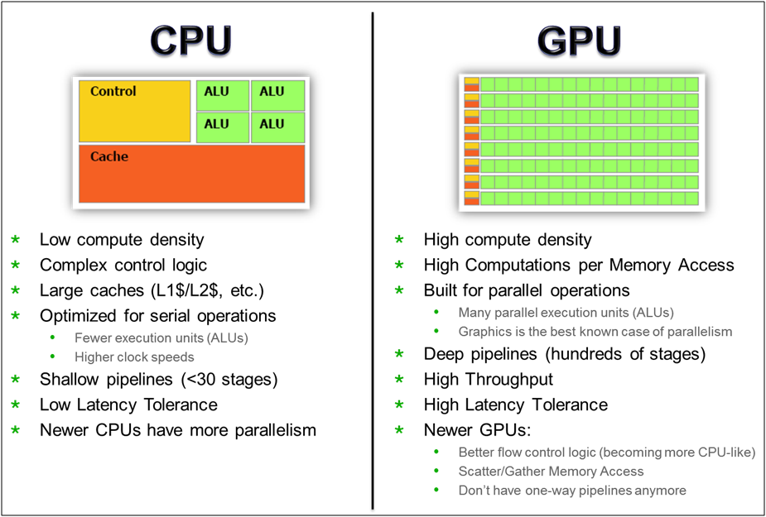
AI Processor

Slide 37
Ecosystem of AI Industry
Unit: million USD

Slide 38
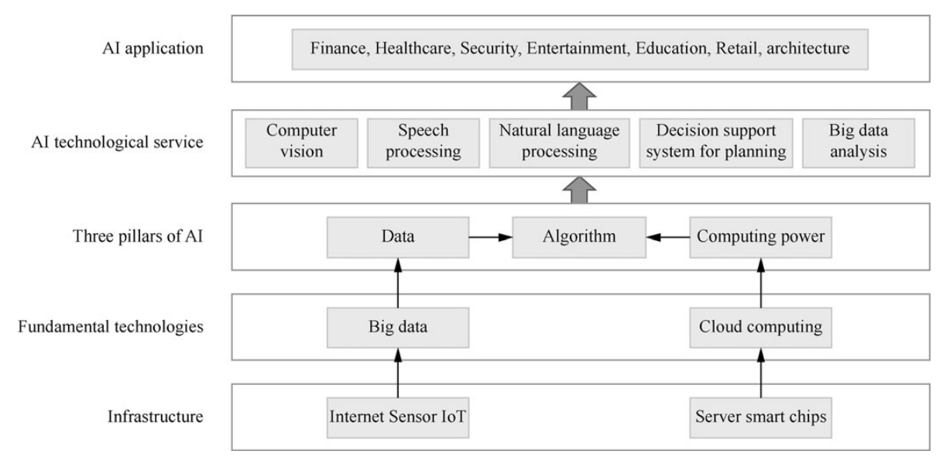
Platform Architecture for AI Applications

Slide 39
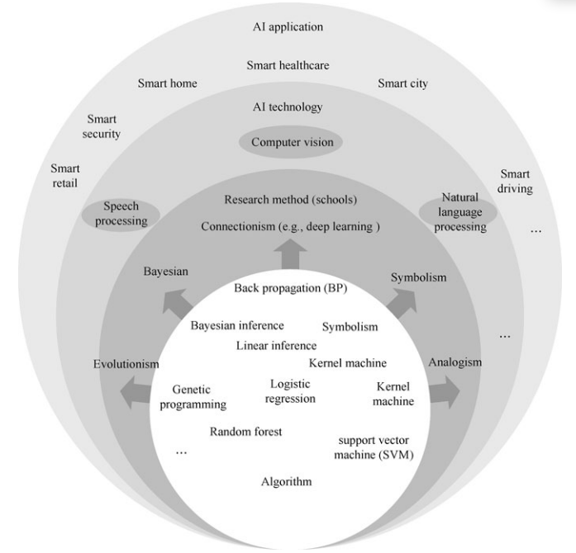
Technologies of AI

Slide 40
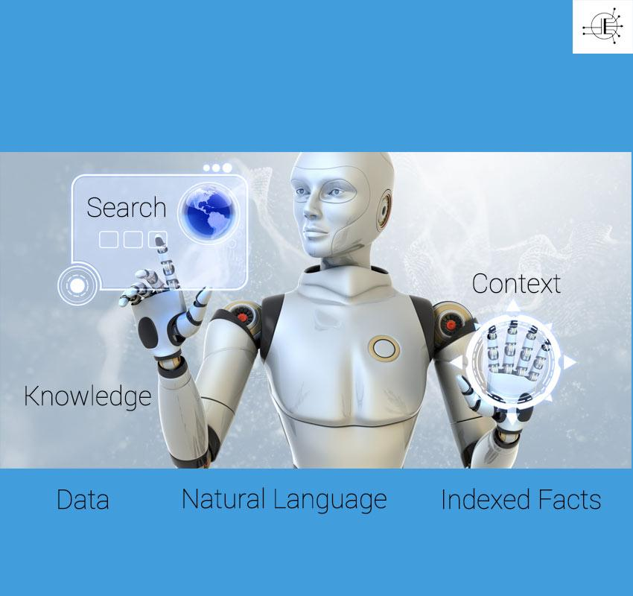
I.Search and problem solving

Slide 41
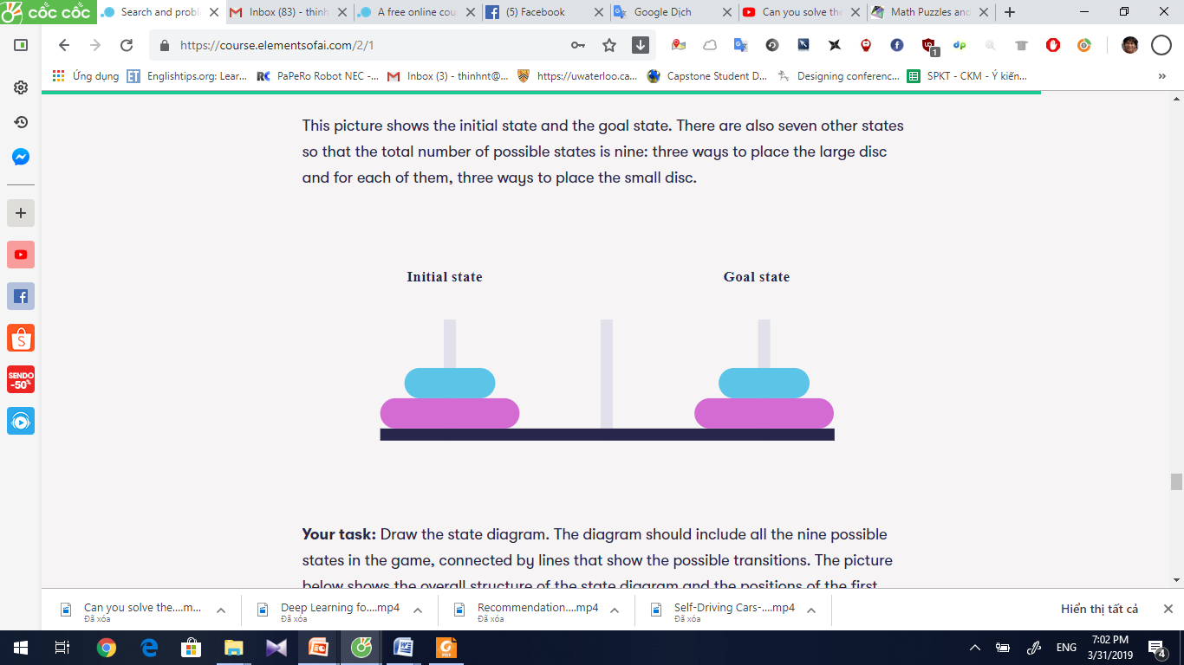
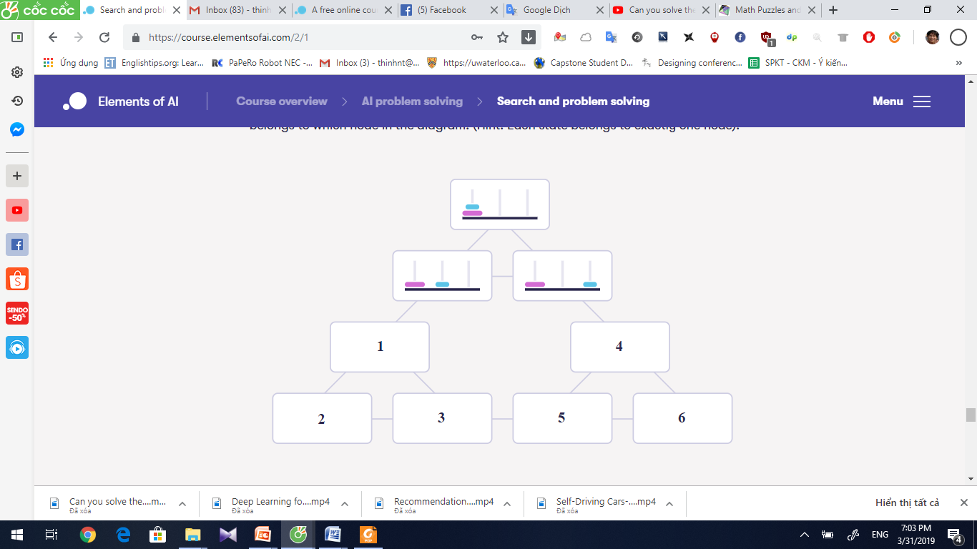
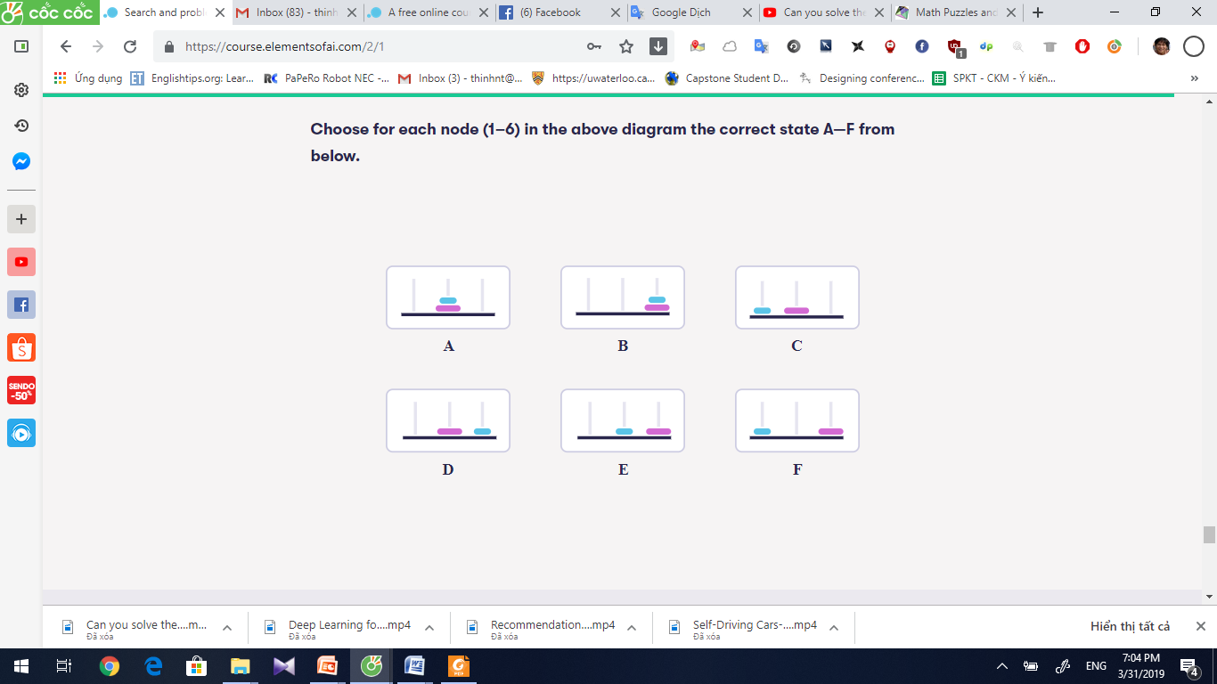
Hanoi Tower

Slide 42
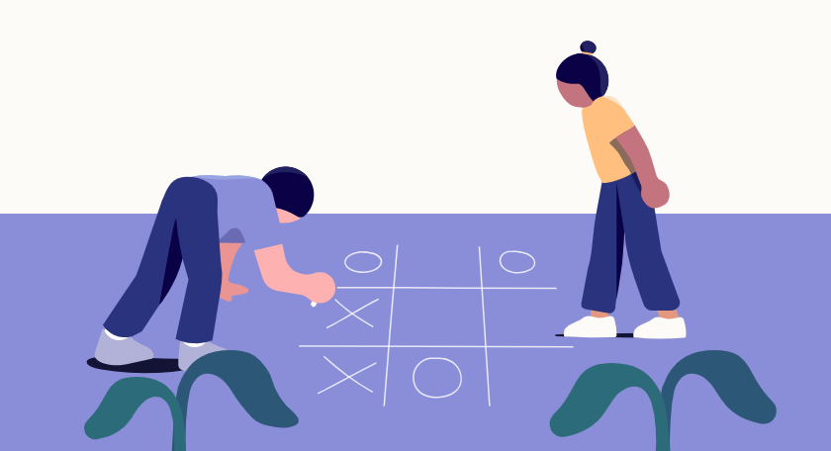
Playing tic tac toe

Slide 43
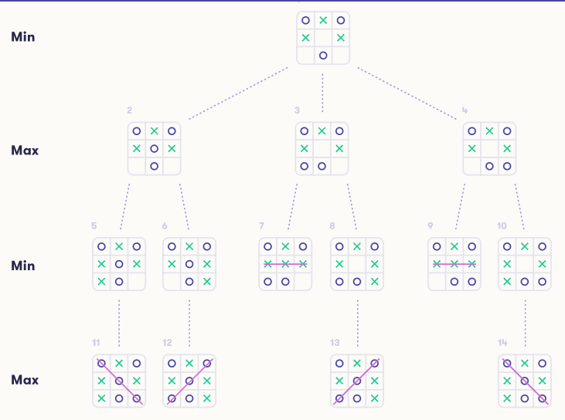

Slide 44
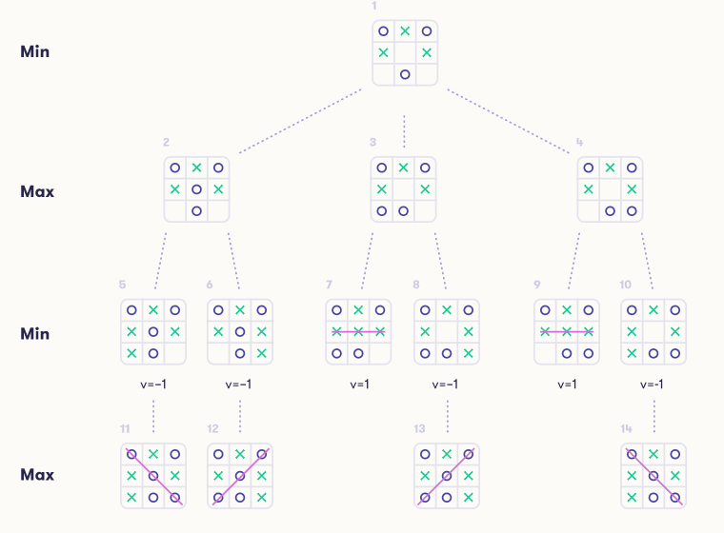

Slide 45


Slide 46


Slide 47
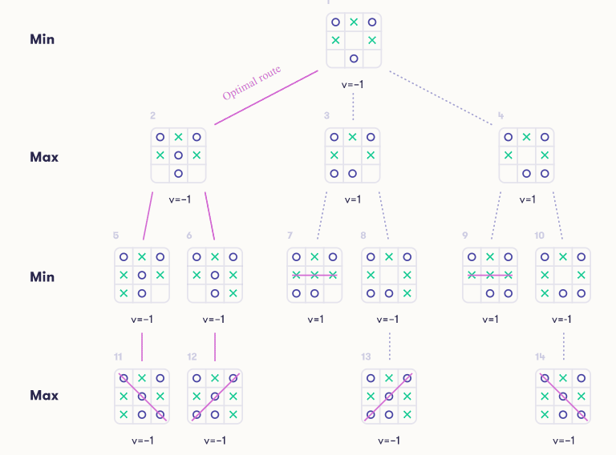

Slide 48
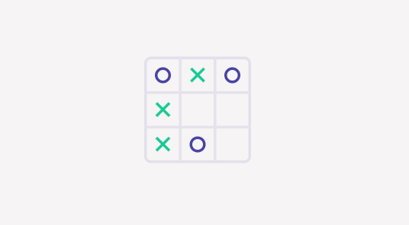
Why so pessimistic, Max?
Let's return to the tic-tac-toe game described in the beginning of this section. To narrow down the space of possible end-games to consider, we can observe that Max must clearly place an X on the top row to avoid imminent defeat:
Now it's Min's turn to play an O. Evaluate the value of this state of the game as well as the other states in the game tree where the above position is the root, using the Minimax algorithm.

Slide 49
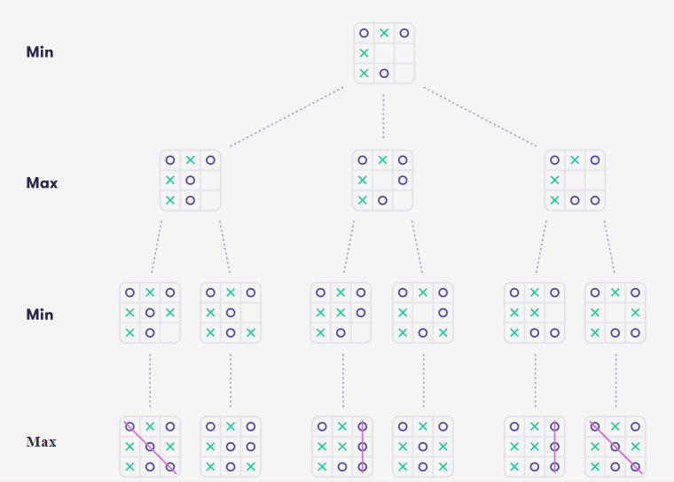

Slide 50
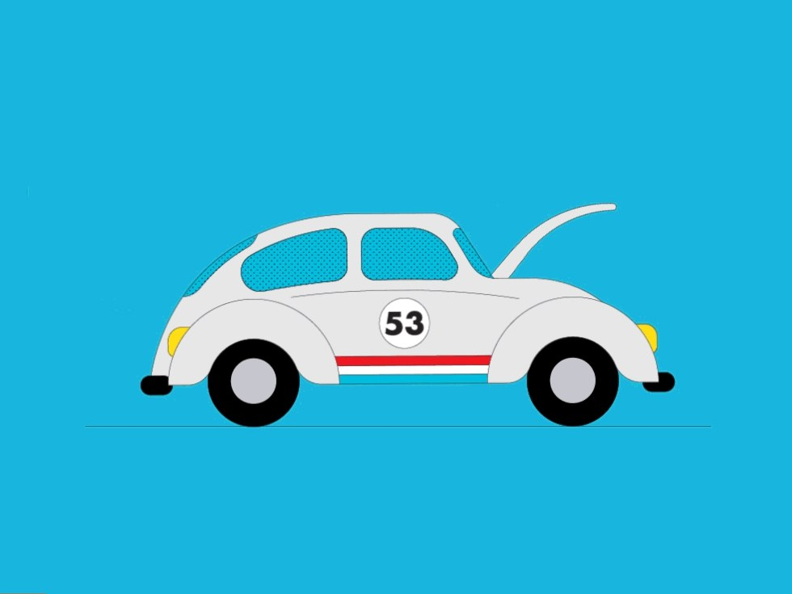
Real world AI

Slide 51
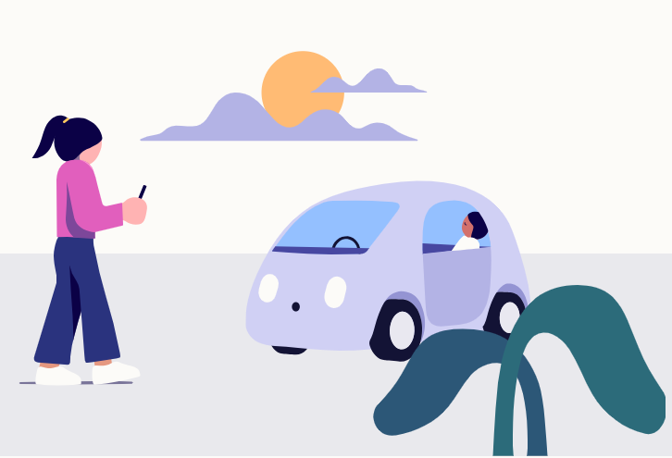
I. Odds and probability

Slide 52
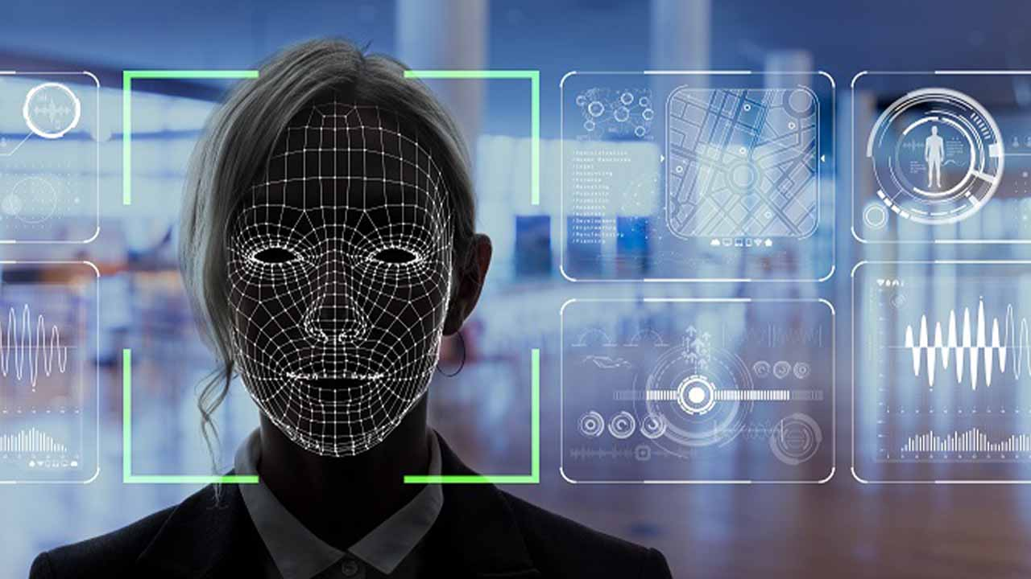
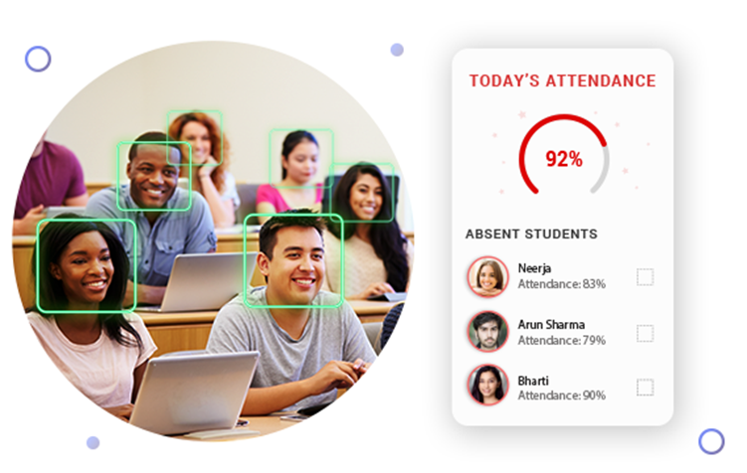
Technologies of AI – computer Vision
Electronic attendance

Slide 53
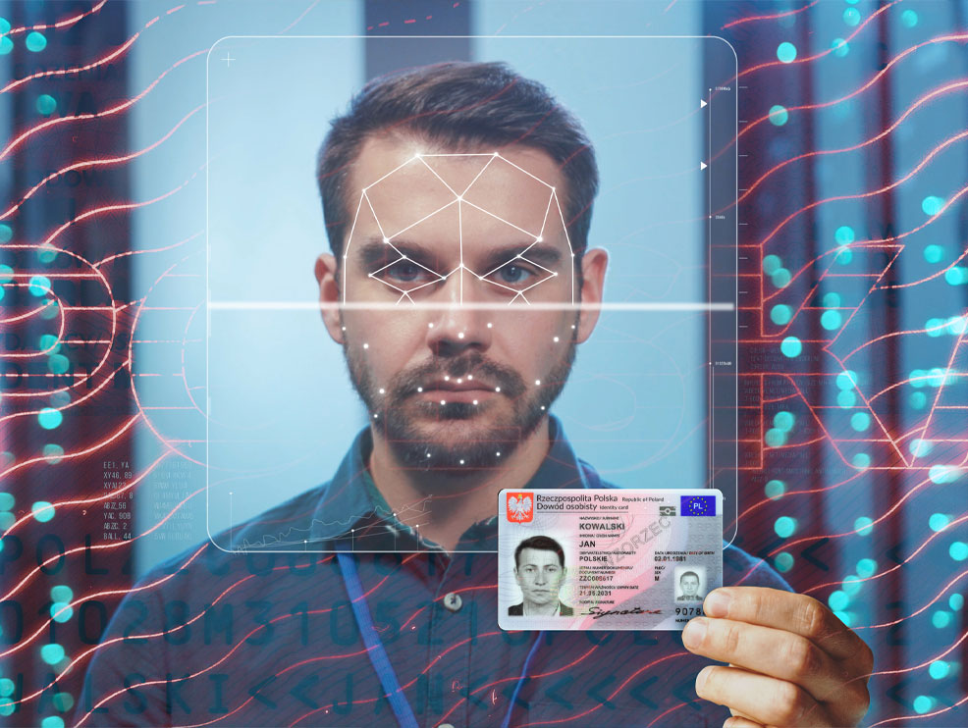
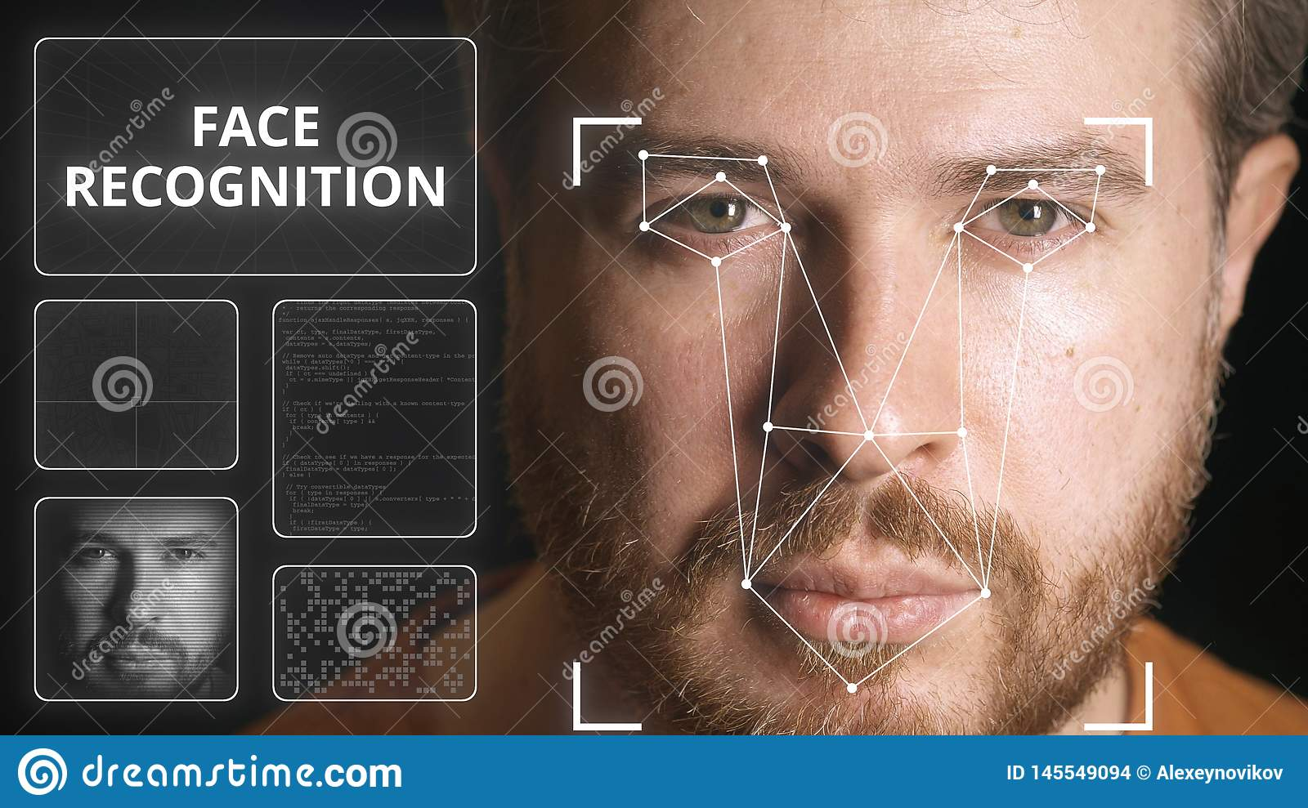
Technologies of AI – computer Vision
Identity verification

Slide 54
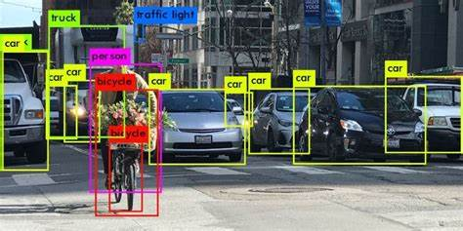
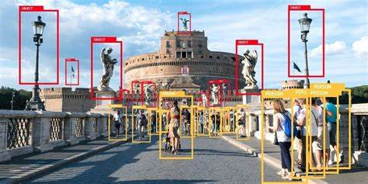
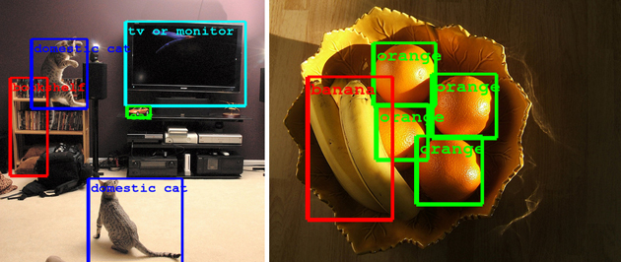
Technologies of AI – computer Vision
Identity Image recognition

Slide 55
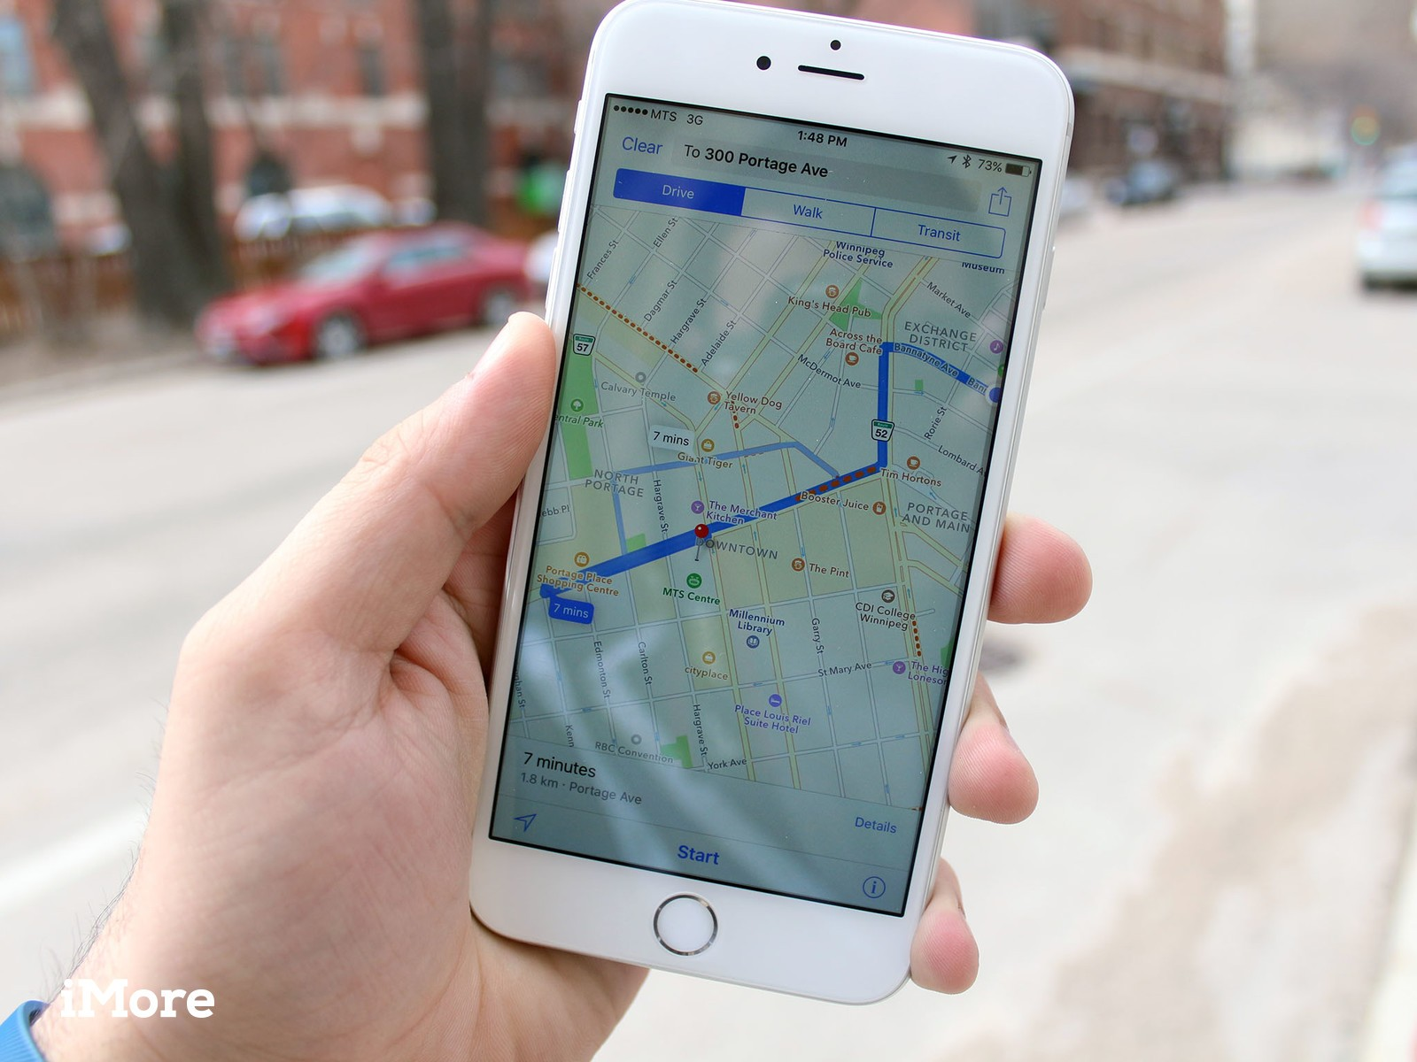
Search in practice: getting from A to B

Slide 56
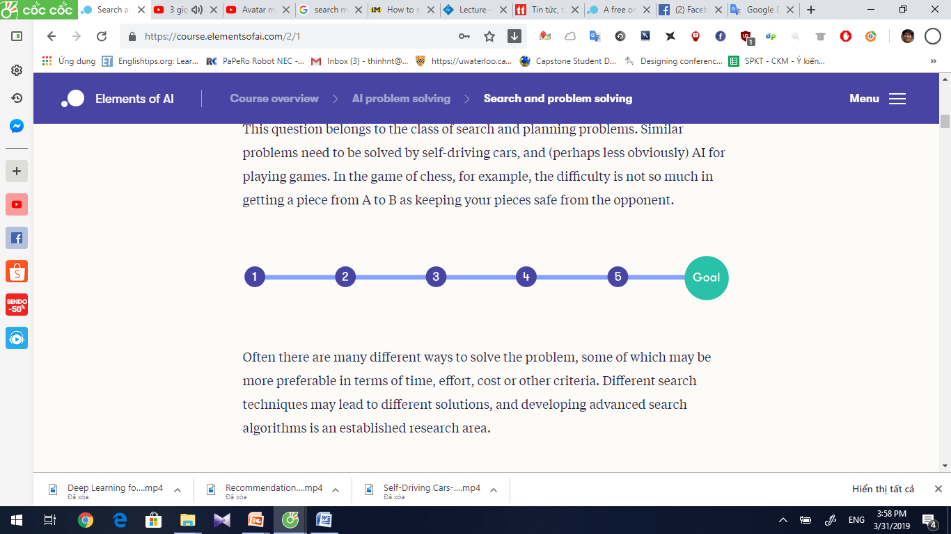
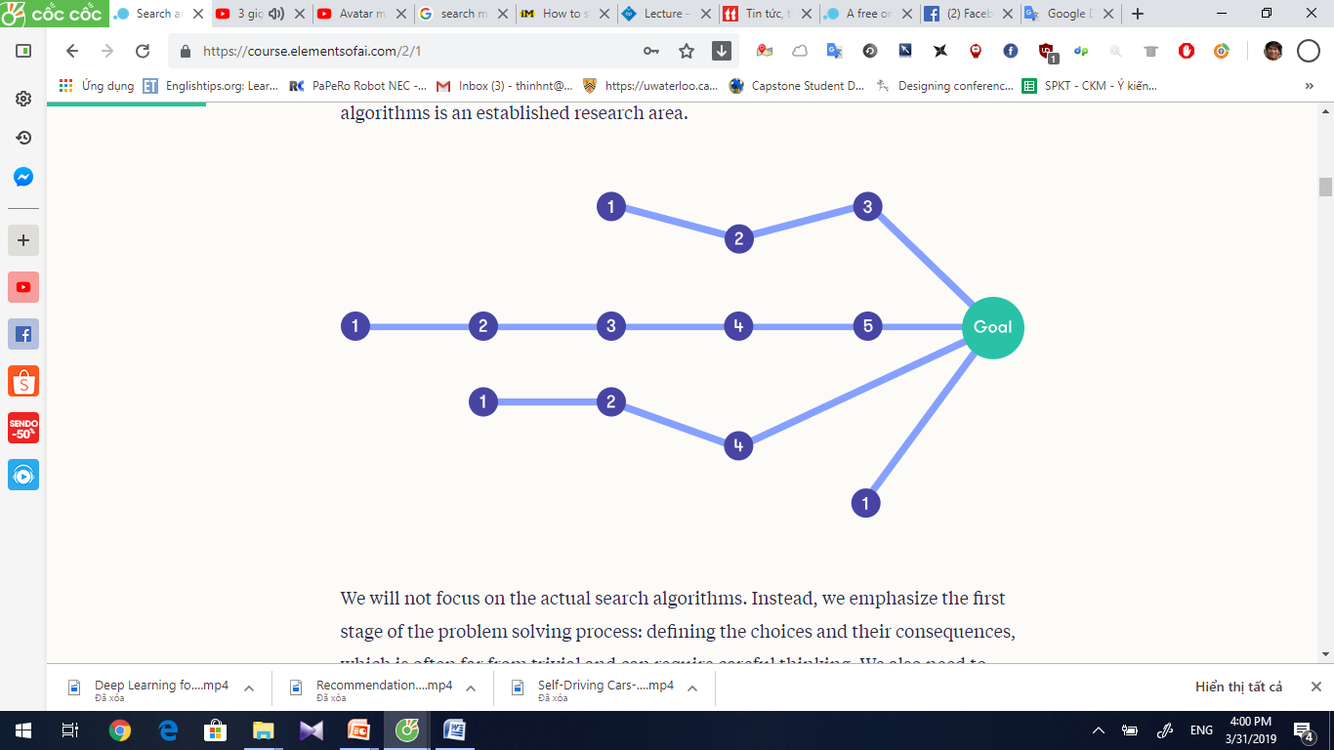
Search in practice: getting from A to B

Slide 57

Toy problem: chicken crossing
We’ll start from a simple puzzle to illustrate the ideas. A robot on a rowboat needs to move three pieces of cargo across a river: a fox, a chicken, and a sack of chicken-feed. The fox will eat the chicken if it has the chance, and the chicken will eat the chicken-feed if it has the chance, and neither is a desirable outcome. The robot is capable of keeping the animals from doing harm when it is near them, but only the robot can operate the rowboat and only two of the pieces of cargo can fit on the rowboat together with the robot. How can the robot move all of its cargo to the opposite bank of the river?

Slide 59
States of the chicken crossing puzzle
State | Robot | Fox | Chicken | Chicken-feed
NNNN | Near side | Near side | Near side | Near side
NNNF | Near side | Near side | Near side | Far side
NNFN | Near side | Near side | Far side | Near side
NNFF | Near side | Near side | Far side | Far side
NFNN | Near side | Far side | Near side | Near side
NFNF | Near side | Far side | Near side | Far side
NFFN | Near side | Far side | Far side | Near side
NFFF | Near side | Far side | Far side | Far side
FNNN | Far side | Near side | Near side | Near side
FNNF | Far side | Near side | Near side | Far side
FNFN | Far side | Near side | Far side | Near side
FNFF | Far side | Near side | Far side | Far side
FFNN | Far side | Far side | Near side | Near side
FFNF | Far side | Far side | Near side | Far side
FFFN | Far side | Far side | Far side | Near side
FFFF | Far side | Far side | Far side | Far side

Slide 60
10 Left states
State | Robot | Fox | Chicken | Chicken-feed
NNNN | Near side | Near side | Near side | Near side
NNNF | Near side | Near side | Near side | Far side
NNFN | Near side | Near side | Far side | Near side
NFNN | Near side | Far side | Near side | Near side
NFNF | Near side | Far side | Near side | Far side
FNFN | Far side | Near side | Far side | Near side
FNFF | Far side | Near side | Far side | Far side
FFNF | Far side | Far side | Near side | Far side
FFFN | Far side | Far side | Far side | Near side
FFFF | Far side | Far side | Far side | Far side

Slide 61
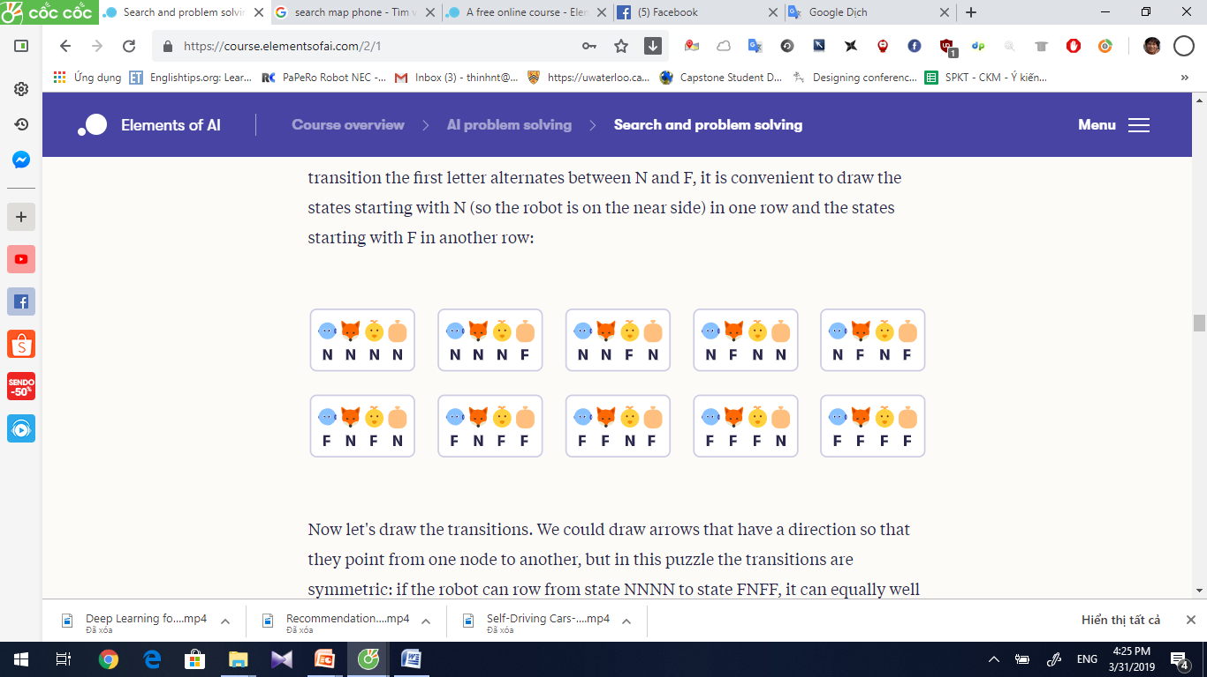


Slide 62


Slide 63

Technologies of AI – computer Vision
Image recognition

Slide 64

Technologies of AI – Speech Processing
Intelligent Q&A

Slide 65
Speech and Voice Recognition
Speech Recognition | Voice Recognition
The speech recognition aims at understanding and comprehending WHAT was spoken. | The objective of voice recognition is to recognize WHO is speaking.
It is used in hand-free computing, map, or menu navigation. | It is used to identify a person by analysing its tone, voice pitch, and accent, etc.
Machine does not need training for Speech Recognition as it is not speaker dependent. | This recognition system needs training as it is person oriented.
Speaker independent Speech Recognition systems are difficult to develop. | Speaker dependent Speech Recognition systems are comparatively easy to develop.

Slide 66

Technologies of AI – Speech Processing
Intelligent navigation

Slide 67

Technologies of AI – Natural Language Processing
Public opinion analysis

Slide 68

Technologies of AI – Natural Language Processing
Comment analysis

Slide 69

Technologies of AI – Natural Language Processing
Machine translation

Slide 70





Real Life Applications of AI Research Areas
Expert Systems Examples − Flight-tracking systems, Clinical systems.
Natural Language Processing Examples: Google Now feature, speech recognition, Automatic voice output.
Neural Networks Examples − Pattern recognition systems such as face recognition, character recognition, handwriting recognition.
Robotics Examples − Industrial robots for moving, spraying, painting, precision checking, drilling, cleaning, coating, carving, etc.
Fuzzy Logic Systems Examples − Consumer electronics, automobiles, etc.

Slide 71

The Applications of AI – Smart city

Slide 72

The Applications of AI – Smart Healthcare

Slide 73



The Applications of AI – Smart Retail

Slide 74

The Applications of AI – Smart Security

Slide 75

The Applications of AI – Smart Home

Slide 76

The Applications of AI – Smart Driving

Slide 77

Current Status of AI

Slide 78

The Contradiction Between Technology and Ethics

Slide 79
Exercises
1. There are different interpretations of artificial intelligence in different contexts. Please elaborate on the artificial intelligence in your eyes.
2. Artificial intelligence, machine learning and deep learning are three concepts often mentioned together. What is the relationship between them? What are the similarities and differences between the three terms?
3. After reading the artificial intelligence application scenarios in this chapter, please describe in detail a field of AI application and its scenarios in real life based on your own life experience.
4. Which chip is for deep neural networks and Ascend AI processors. Please brief these four major modules.
5. Based on your current knowledge and understanding, please elaborate on the development trends of artificial intelligence in the future in your view.

